Slide 1

SHREE RAMSWAROOP MEMORIAL UNIVERSITY
Assignment:-15
Java Enterprise Edition Lab - 15
Submitted to:
Submitted by:
Vidushi Srivastava
Mukesh Prajapati
Btech (Cse Industry integrated)
Roll No – 202410101230007

Slide 2
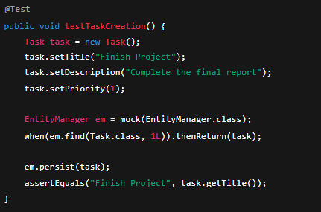
Step 1: Functional Testing (Unit and Integration Tests)
Use JUnit to test individual classes and methods.
JUnit Key Annotations:
@Test — Marks a method as a test.
@BeforeEach / @BeforeAll — Runs setup code before tests.
@AfterEach / @AfterAll — Runs cleanup code after tests.
@Disabled — Temporarily disables a test.

Slide 3

Step 2: Usability Testing
Test the application’s user-friendliness. Process:
Create realistic test scenarios (e.g., assign a task, update profile).
Have users attempt these tasks.
Observe ease of navigation and gather feedback.
´ ’◎"● Goal: Identify pain points in layout, labeling, and navigation to improve UX.
Step 3: Security Testing
Perform vulnerability assessments for:
  SQL Injection
  Cross-Site Scripting (XSS)
  Cross-Site Request Forgery (CSRF) Example – SQL Injection:
+ Vulnerable:
⬛ Secure:
Example – XSS Protection:
Use OWASP ZAP or Burp Suite to scan for vulnerabilities.

Slide 4

Step 4: Penetration Testing
Simulate real-world attacks using:
Burp Suite — For manual attack simulation (SQLi, XSS, CSRF).
OWASP ZAP — For automated scanning.
●◎’" ´ Purpose: Verify application defenses against realistic threats.
Step 5: Fix Security Vulnerabilities
After identifying issues, update the code:
Validate and sanitize all user input.
Use prepared statements (prevent SQLi).
Use CSRF tokens for sensitive actions.
Example – CSRF Token Implementation:
In JSP:
Step 6: Test Automation
Automate:
Backend tests → with JUnit.
UI tests → with Selenium WebDriver.
Automation ensures consistency and quick detection of regressions.
Step 7: Testing Checklist Test Type Purpose
Functional Verify all features work correctly Usability Ensure smooth user experience

Slide 5
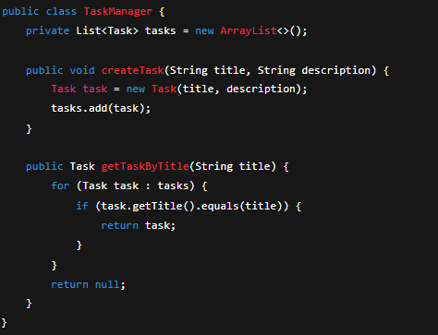
Test Type
Purpose
Security Identify and fix vulnerabilities
Penetration Simulate real attacks to validate security
Step 8: Error Handling
Display user-friendly error messages.
Log security events for auditing and investigation.
Step 9: Final Outcomes
⬛ Fully tested for functionality, usability, and security.
⬛ All identified vulnerabilities resolved.
⬛ Detailed documentation of tests and results prepared.
⬛ Application ready for deployment.
Example Code – TaskManage

Slide 6
